Slide 1

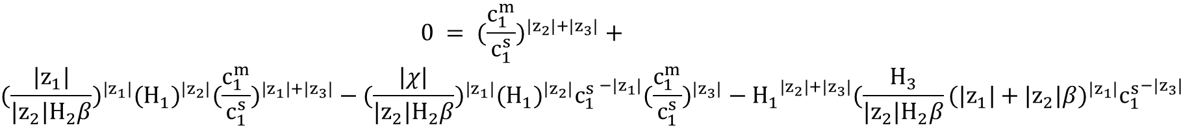
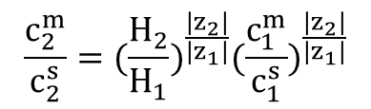

Calculating & Plotting $H_{theoretical}$
$$c_{1}^{s}=\frac{2I}{{|z}_{1}|(|z_{1}|+|z_{3}|)+|z_{2}|β({|z}_{2}|+|z_{3}|)}$$
$$β=\frac{c_{2}^{s}}{c_{1}^{s}};c_{2}^{s}=βc_{1}^{s}$$
$$\frac{c_{2}^{m}}{c_{2}^{s}}={(\frac{H_{2}}{H_{1}})}^{\frac{{|z}_{2}|}{{|z}_{1}|}}{(\frac{c_{1}^{m}}{c_{1}^{s}})}^{\frac{{|z}_{2}|}{{|z}_{1}|}}$$
$$0 = {(\frac{c_{1}^{m}}{c_{1}^{s}})}^{{|z}_{2}|+{|z}_{3}|} +$$
$${(\frac{{|z}_{1}|}{{|z}_{2}|H_{2}β})}^{{|z}_{1}|}{(H_{1})}^{|z_{2}|}{(\frac{c_{1}^{m}}{c_{1}^{s}})}^{{|z}_{1}|+{|z}_{3}|} −{ (\frac{|χ|}{{|z}_{2}|H_{2}β})}^{{|z}_{1}|}{(H_{1})}^{|z_{2}|}{c_{1}^{s }}^{−|z_{1}|}{(\frac{c_{1}^{m}}{c_{1}^{s}})}^{|z_{3}|} − {H_{1}}^{{|z}_{2}|+{|z}_{3}|}{(\frac{H_{3}}{{|z}_{2}|H_{2}β}(|z_{1}|+|z_{2}|β)}^{|z_{1}|}{c_{1}^{s}}^{−|z_{3}|}$$
Notes:
Bill: raised the H1H3 equation by exponent z2/z1 to simplify. Defined an H* stemming from ratio of H1/H3 and H2/H3 equations.

Slide 2
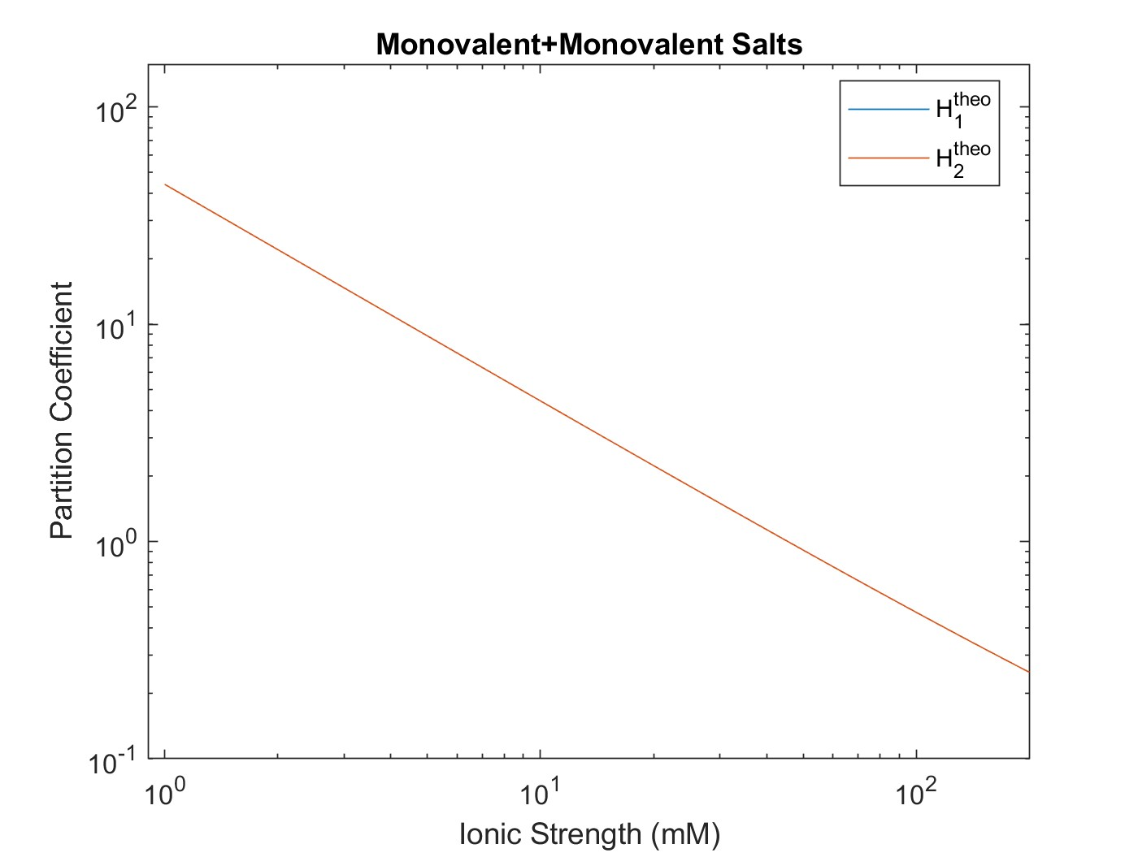
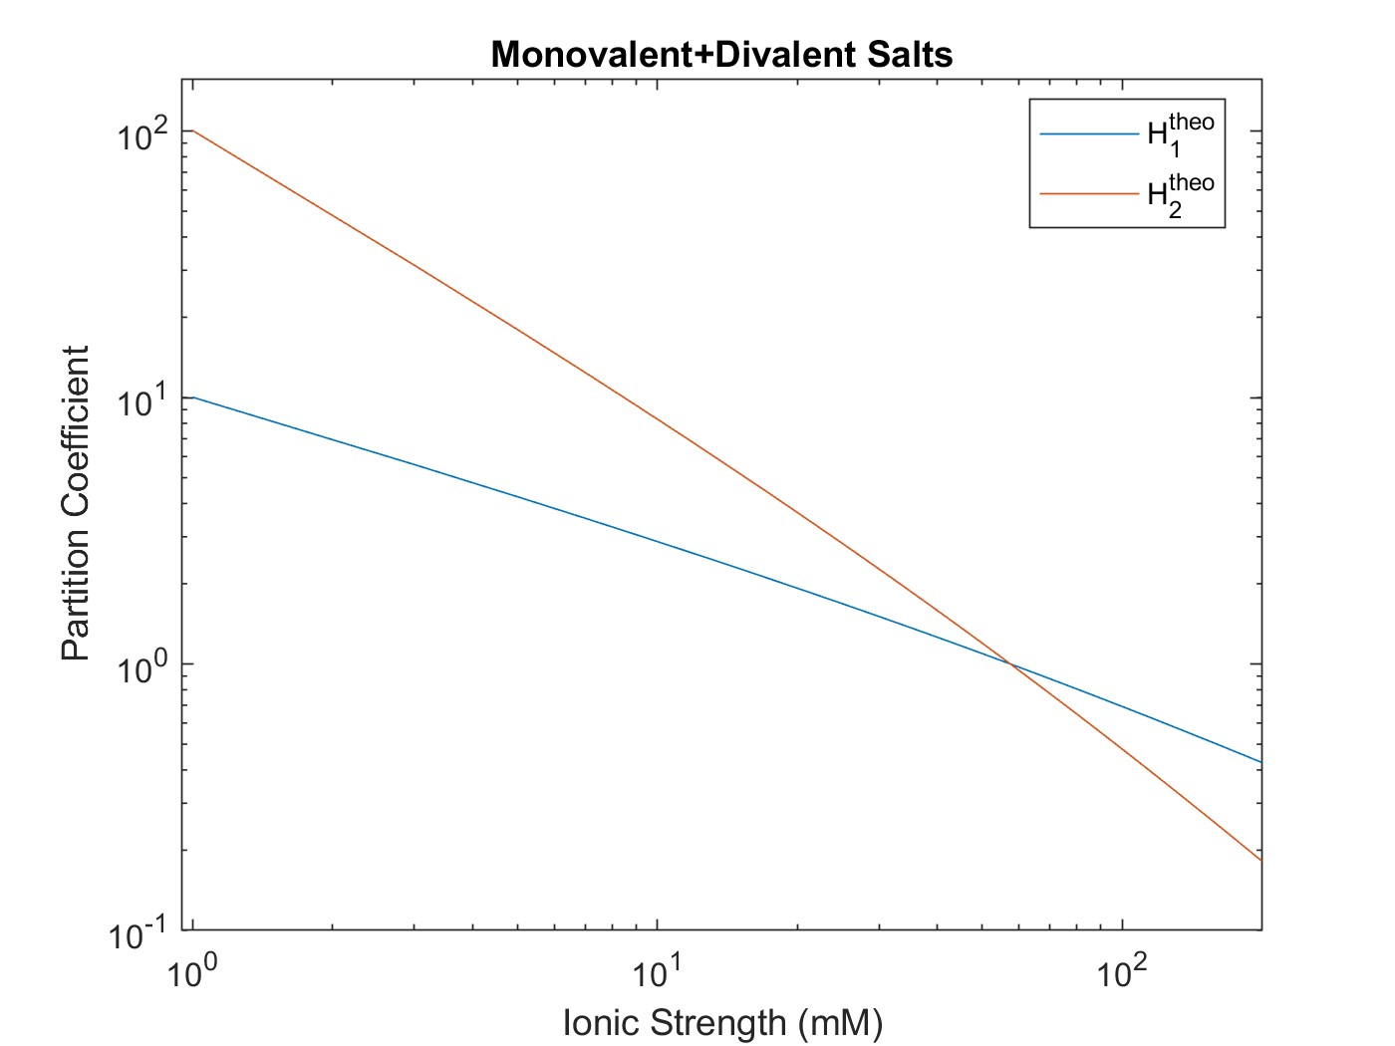
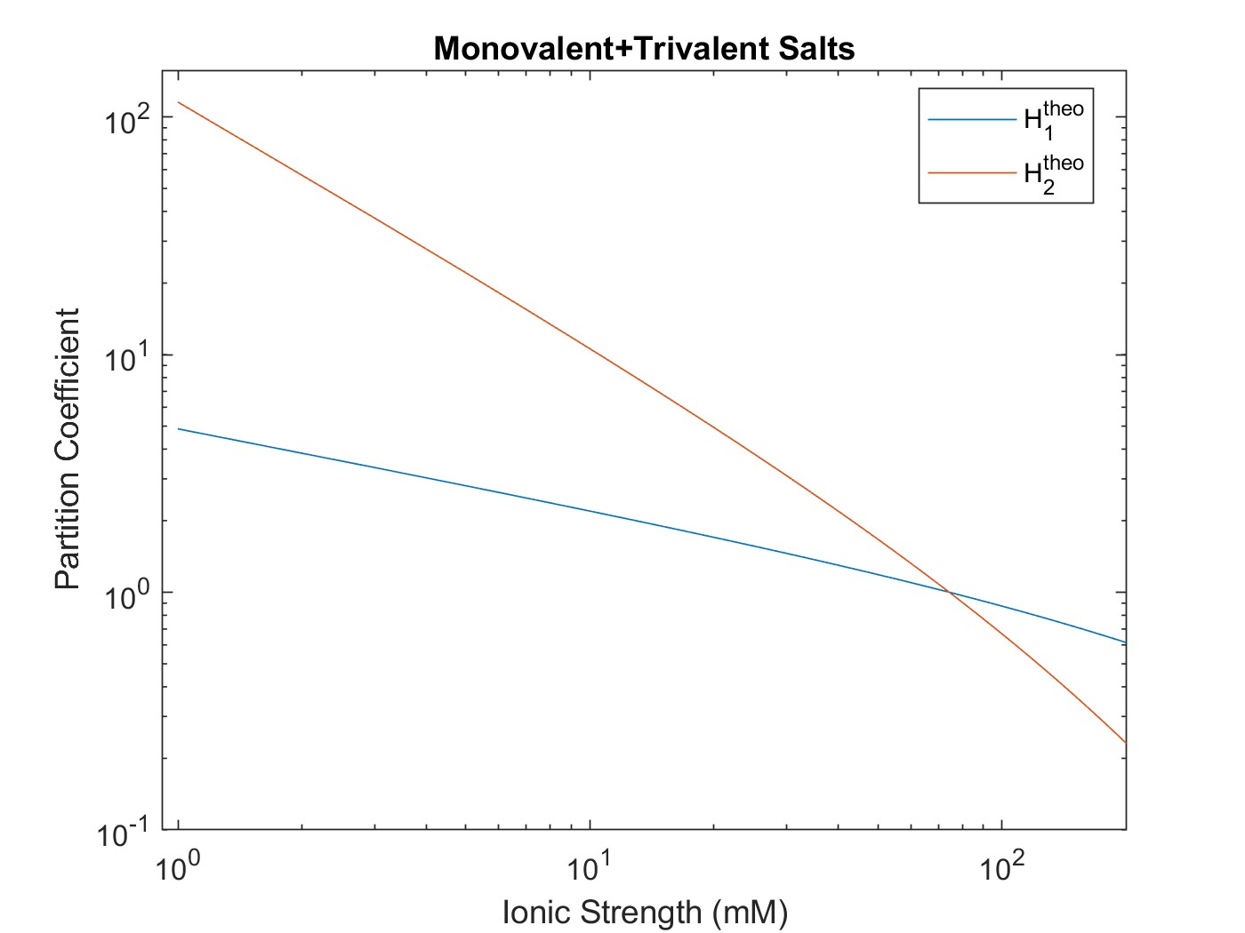
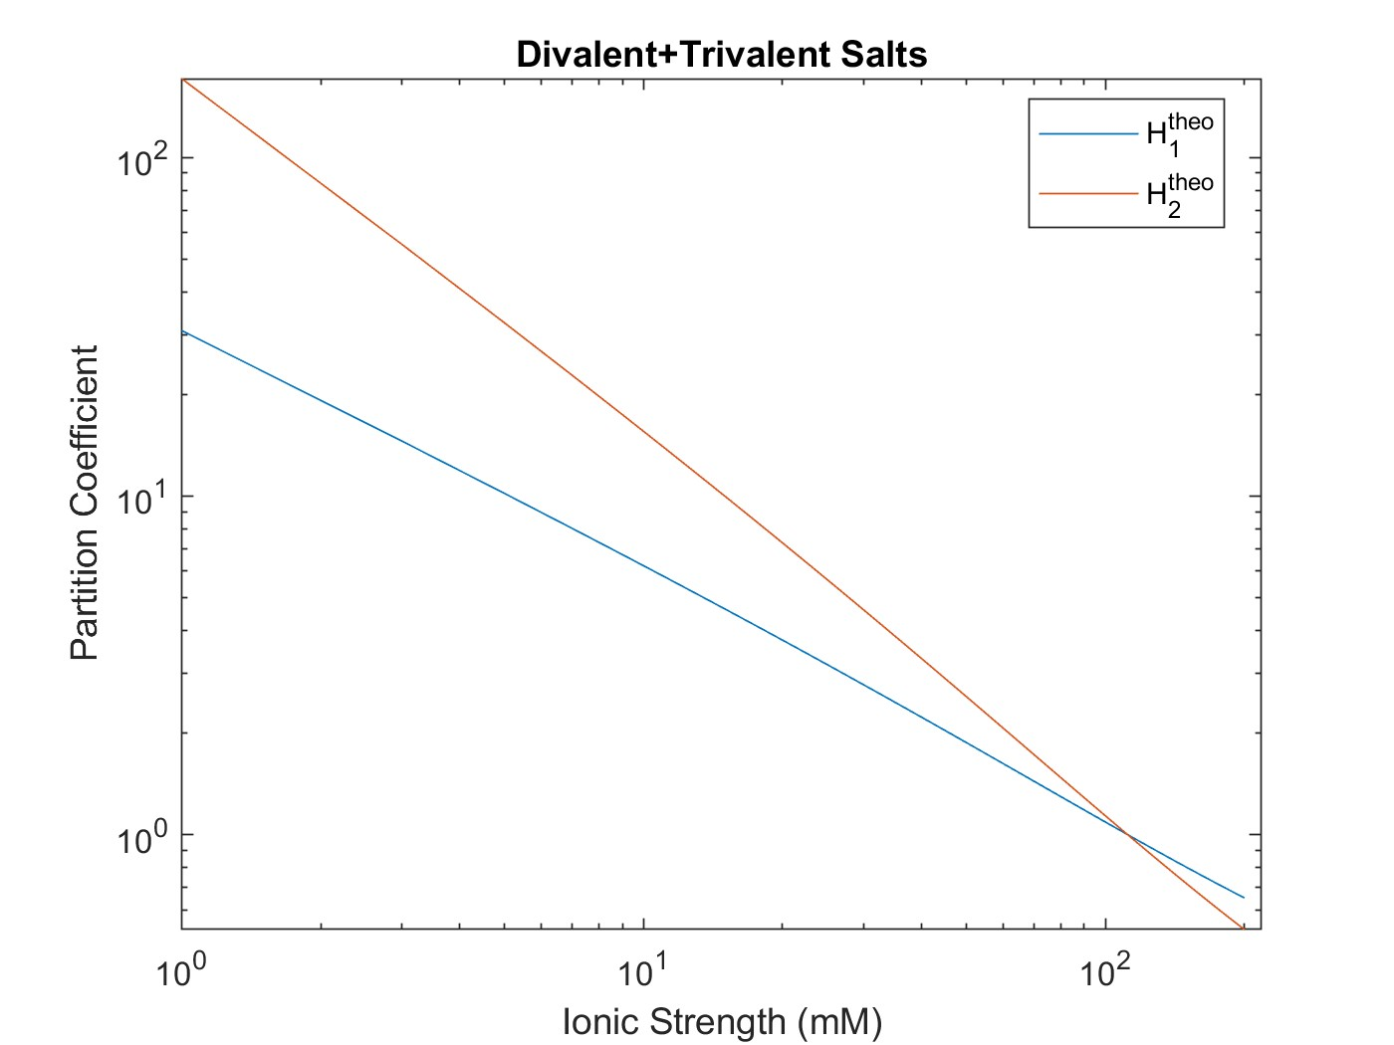
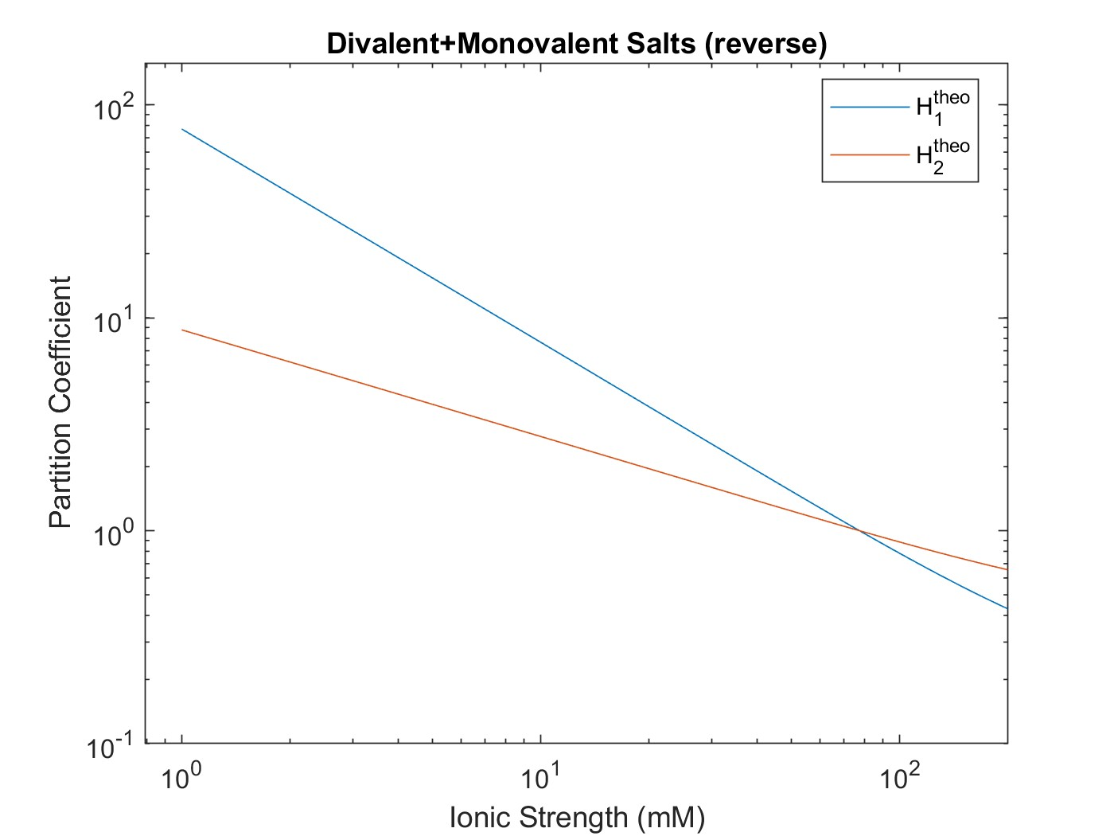
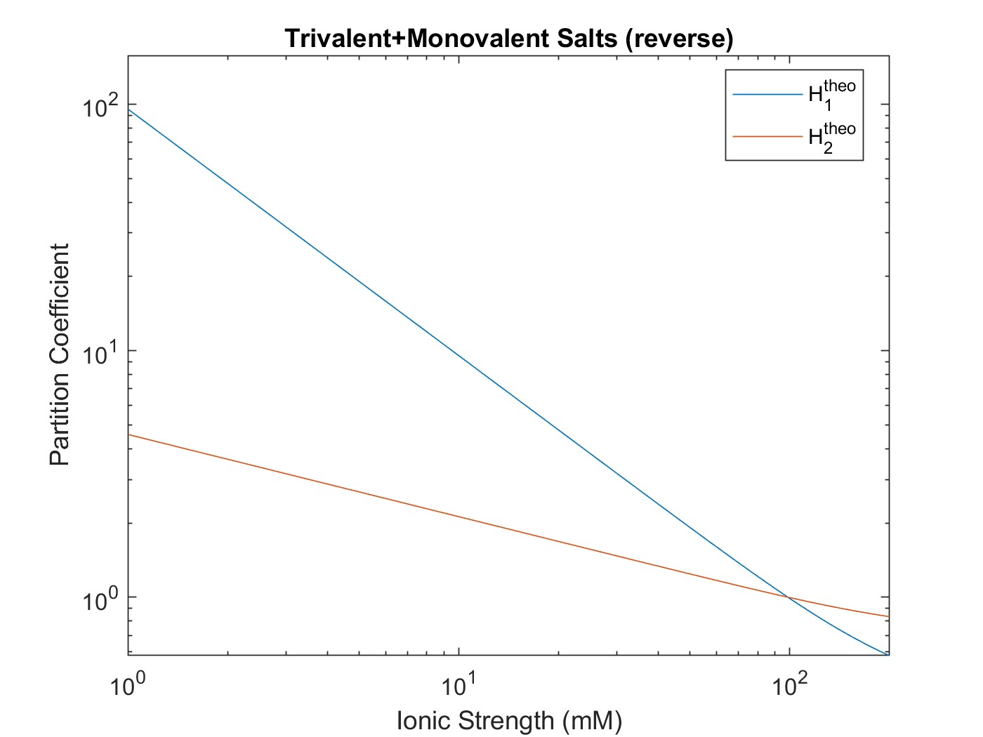
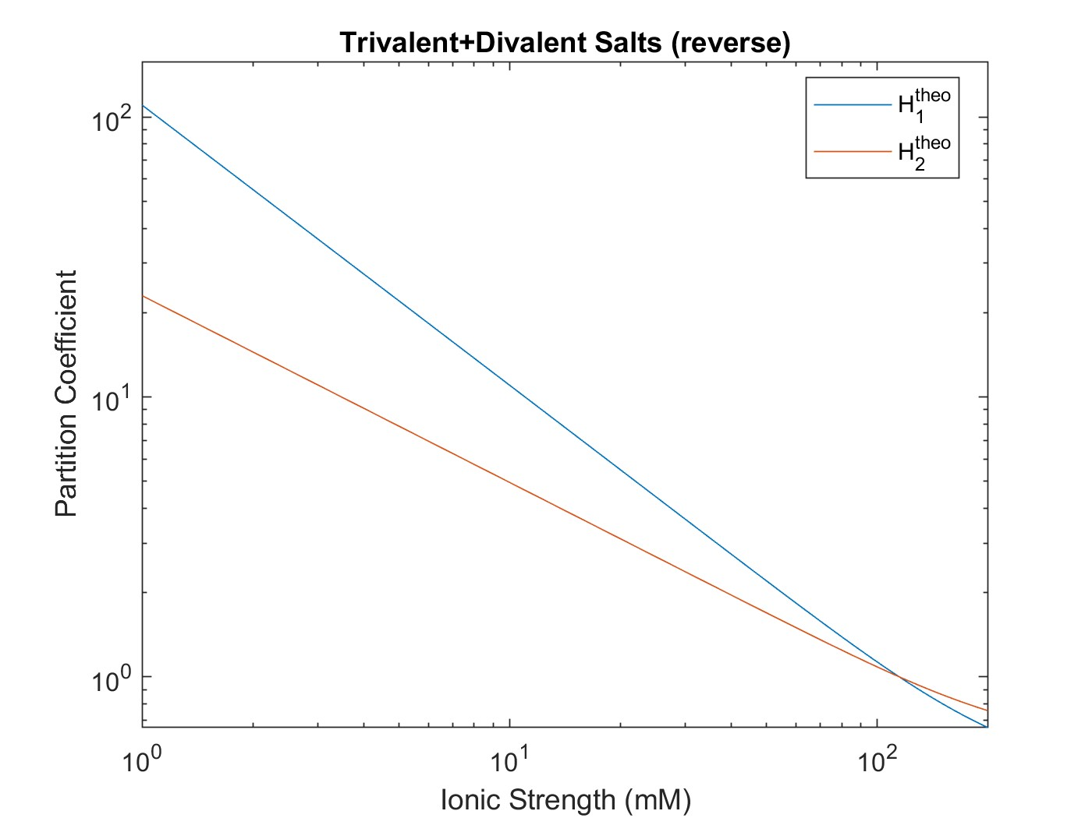
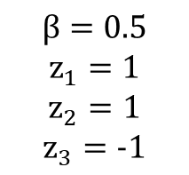
Calculating & Plotting $H_{theoretical}$
$$β=0.5$$
$$z_{1}=1$$
$$z_{2}=1$$
$$z_{3}=−1$$
Notes:
Bill: raised the H1H3 equation by exponent z2/z1 to simplify. Defined an H* stemming from ratio of H1/H3 and H2/H3 equations.

Slide 3
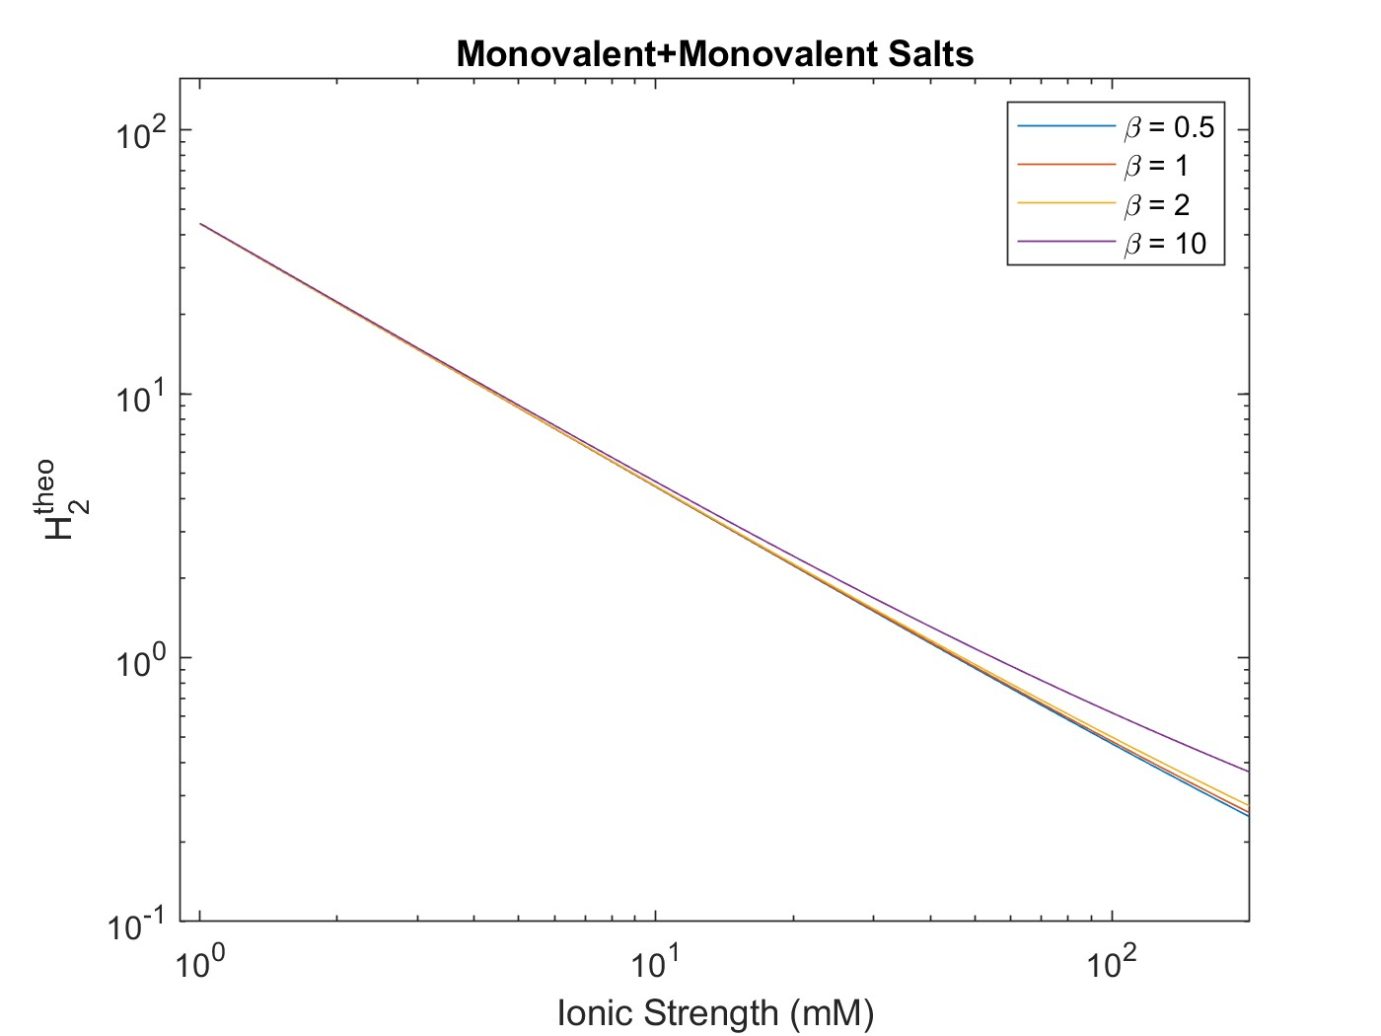

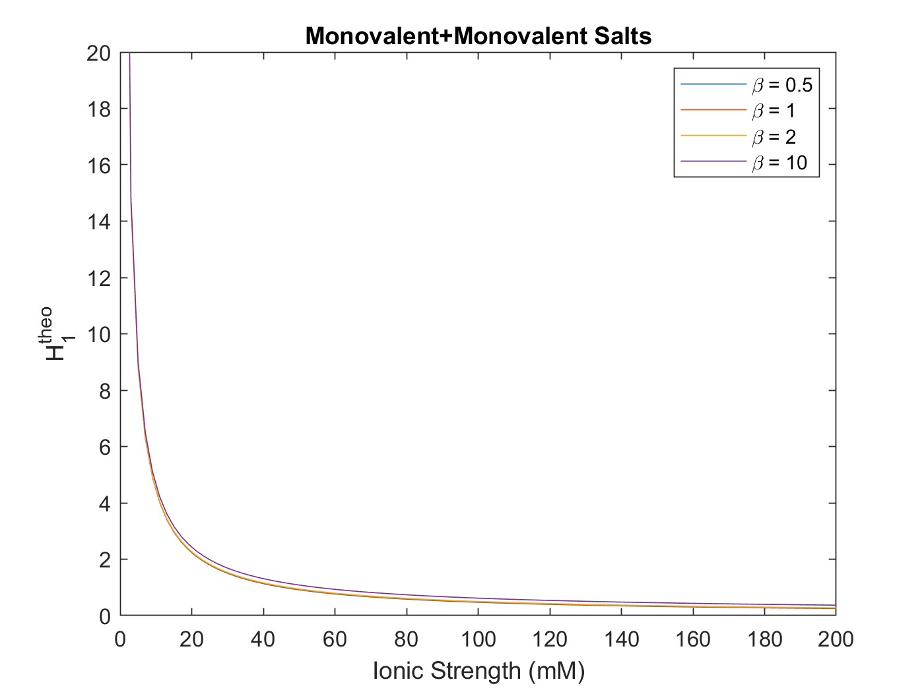

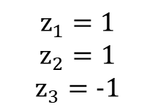
Calculating & Plotting $H_{theoretical}$
$$z_{1}=1$$
$$z_{2}=1$$
$$z_{3}=−1$$
Notes:
Bill: raised the H1H3 equation by exponent z2/z1 to simplify. Defined an H* stemming from ratio of H1/H3 and H2/H3 equations.

Slide 4
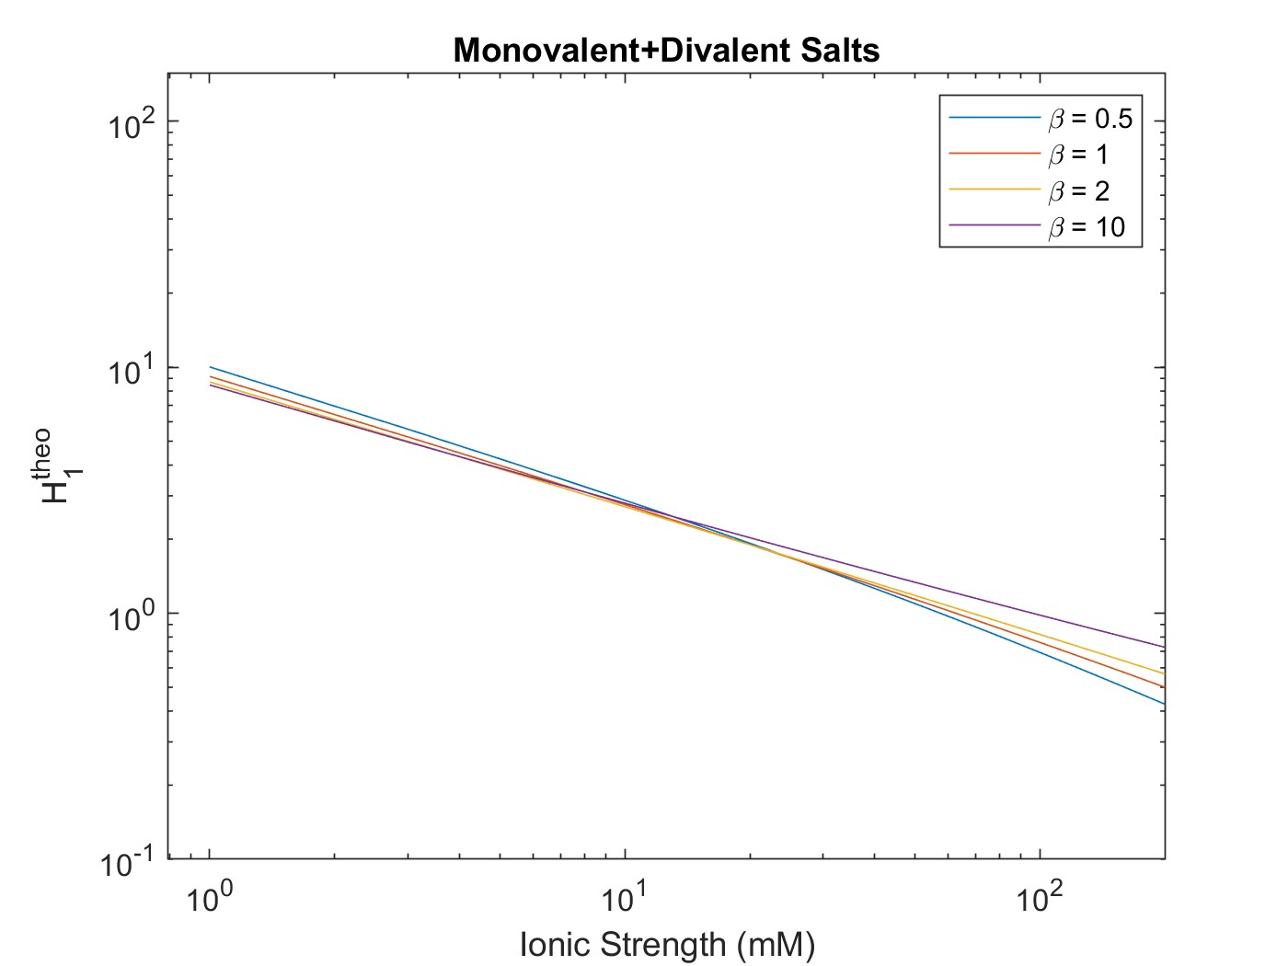
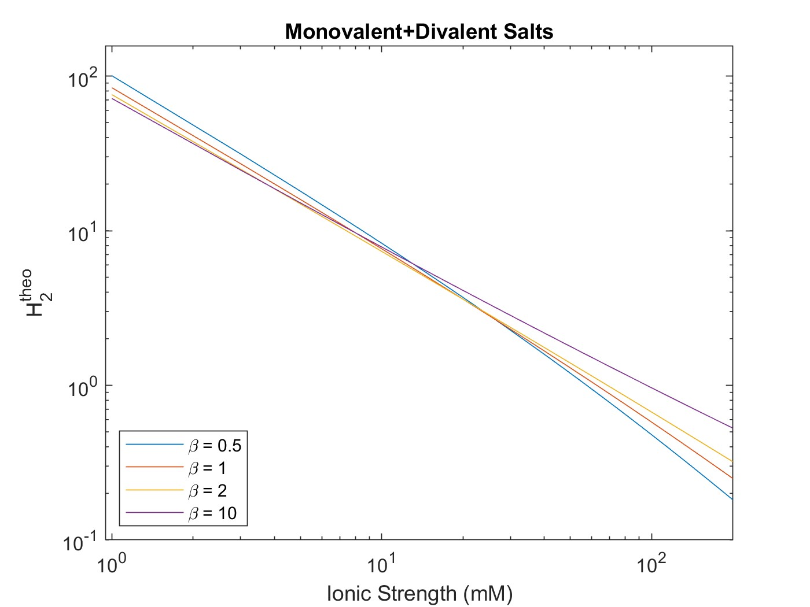
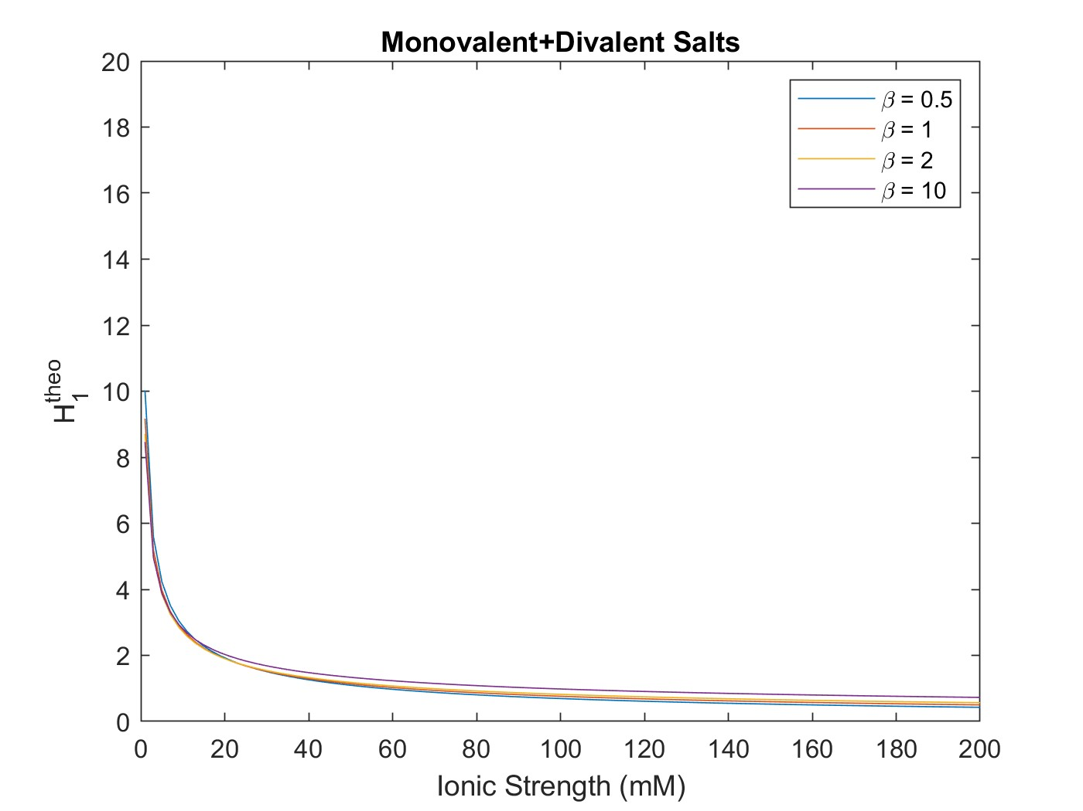
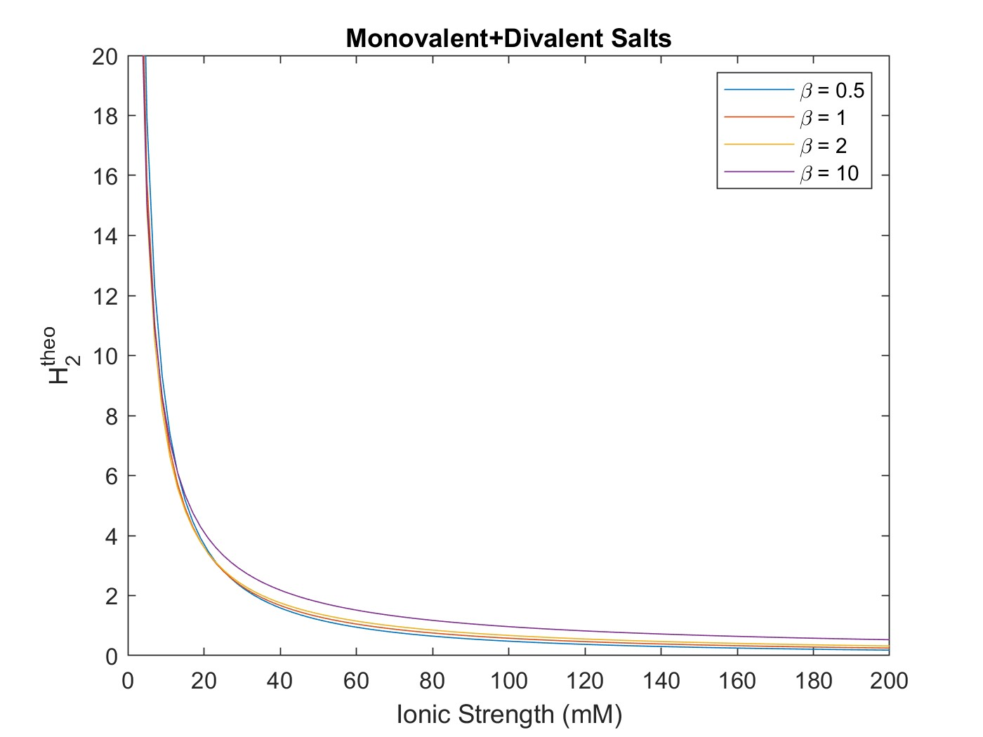
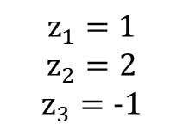
Calculating & Plotting $H_{theoretical}$
$$z_{1}=1$$
$$z_{2}=2$$
$$z_{3}=−1$$
Notes:
Bill: raised the H1H3 equation by exponent z2/z1 to simplify. Defined an H* stemming from ratio of H1/H3 and H2/H3 equations.

Slide 5
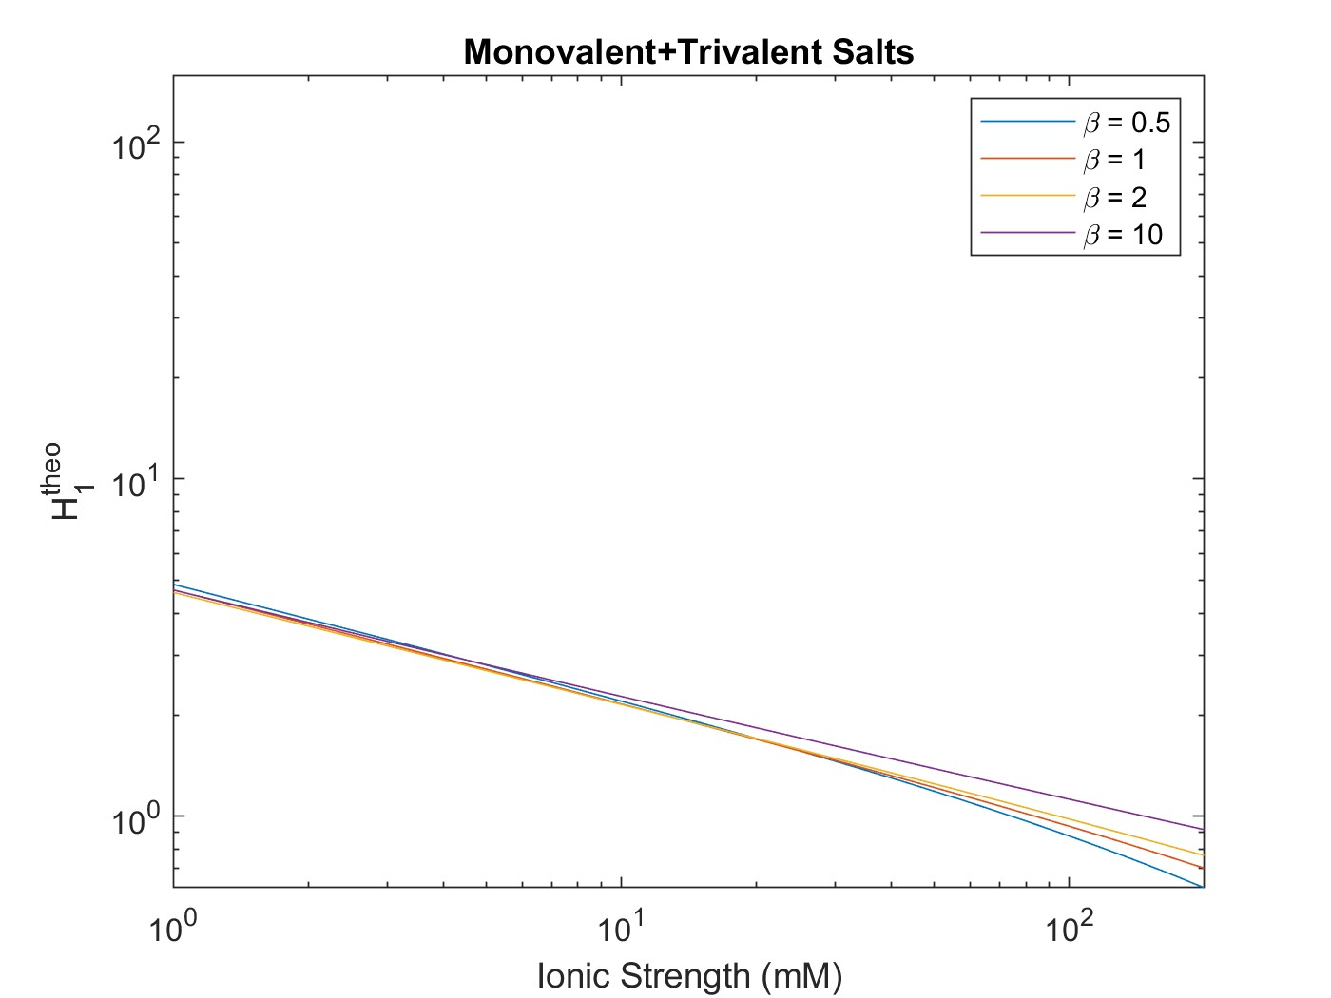
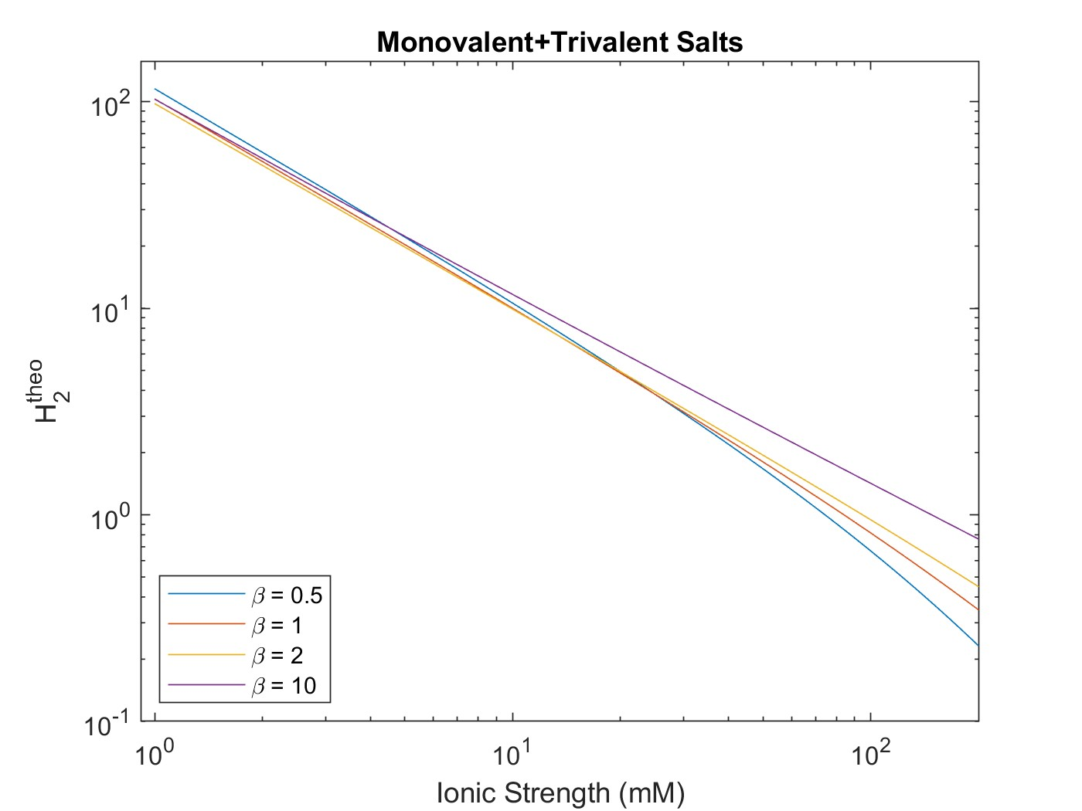
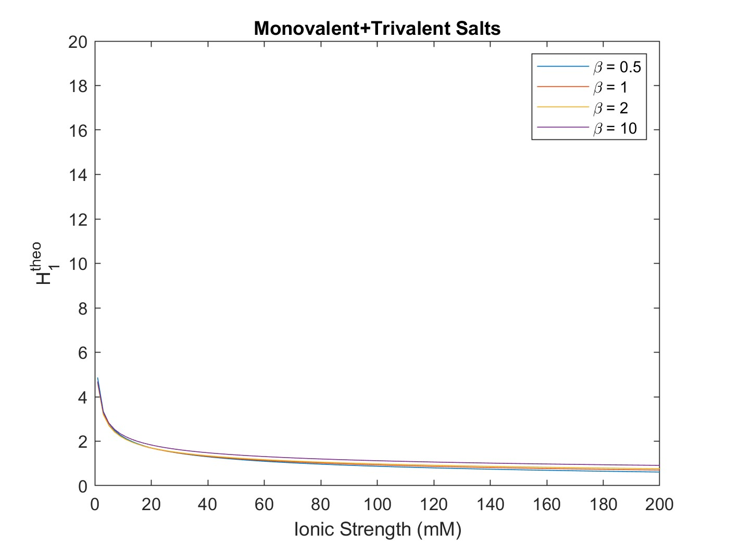
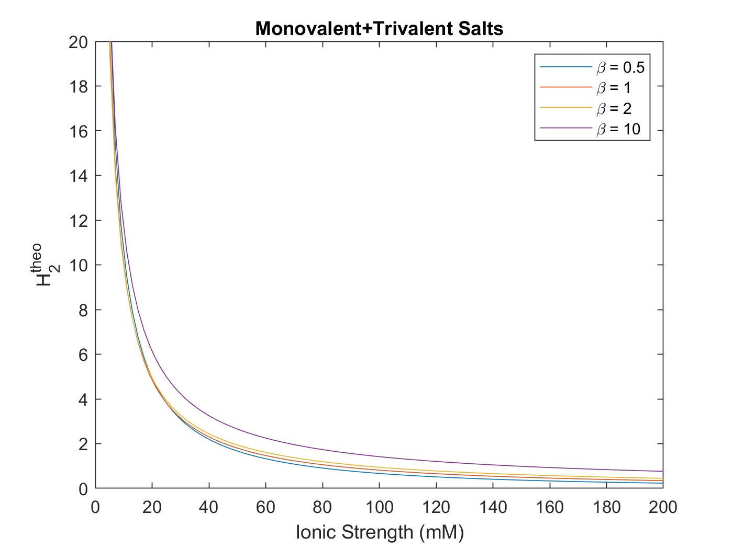
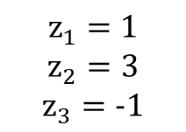
Calculating & Plotting $H_{theoretical}$
$$z_{1}=1$$
$$z_{2}=3$$
$$z_{3}=−1$$
Notes:
Bill: raised the H1H3 equation by exponent z2/z1 to simplify. Defined an H* stemming from ratio of H1/H3 and H2/H3 equations.

Slide 6
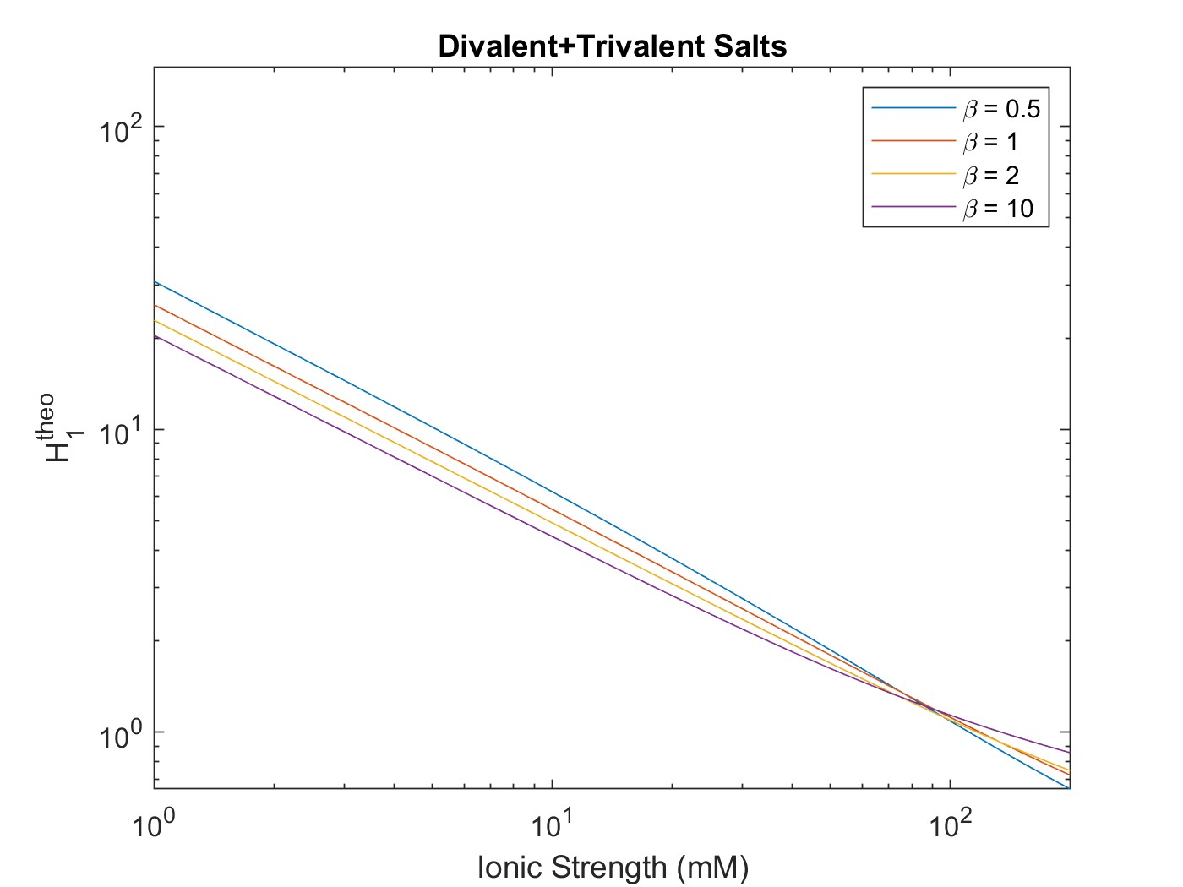
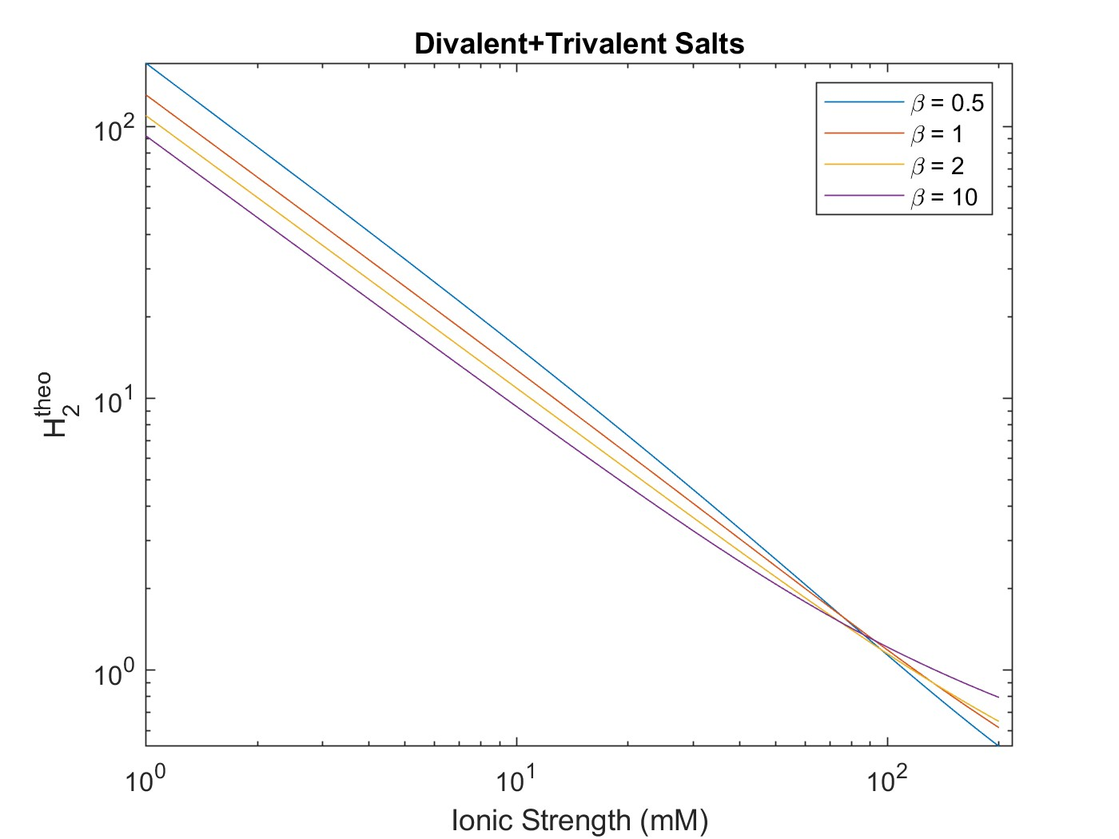
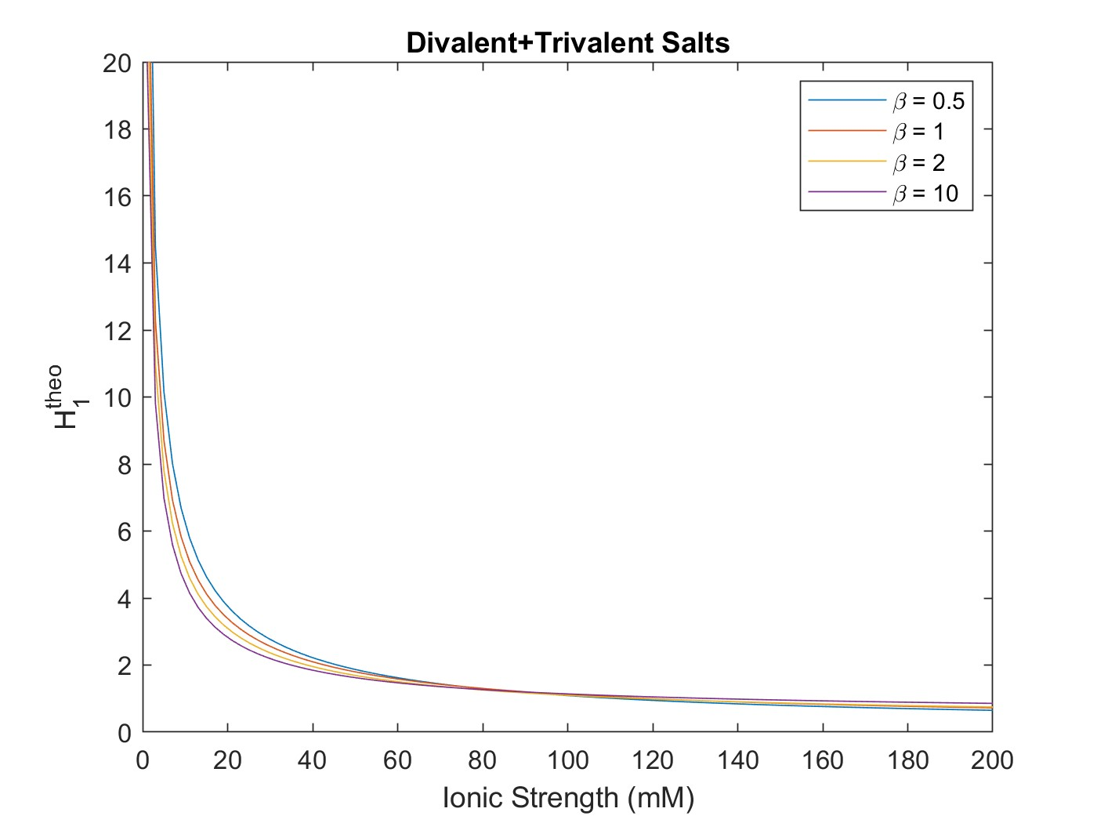
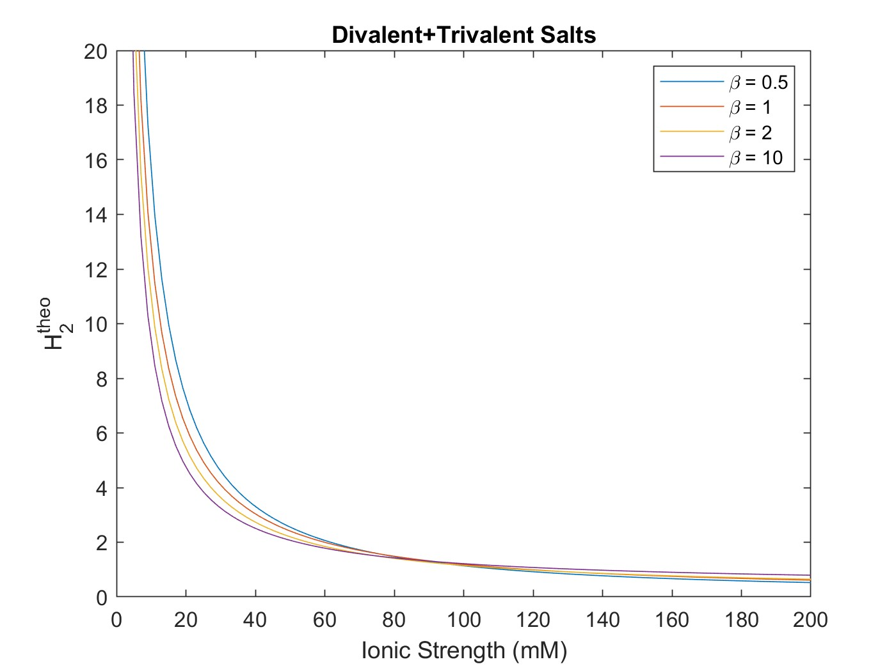
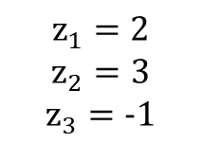
Calculating & Plotting $H_{theoretical}$
$$z_{1}=2$$
$$z_{2}=3$$
$$z_{3}=−1$$
Notes:
Bill: raised the H1H3 equation by exponent z2/z1 to simplify. Defined an H* stemming from ratio of H1/H3 and H2/H3 equations.

